Slide 1
Citrus Detection
Name

Slide 2
Outline
Task Introduction
Related Work
Challenge & Insight
Formulation
Experiments
Discussion & Conclusion

Slide 3
Task Introduction:
Fruit detection for Robotic Harvesting
Background
+ Harvesting of specialty crops such as apples, citrus, cherries and pears is highly labor intensive
Target Problem
+ Detect citrus fruits on given images
+ Input: images containing citrus in orchard environment
+ Output: citrus fruit segmentation

Slide 4
Related Work
Sensors and system
+ Black and white cameras + Color cameras
+ Spectral cameras + Thermal cameras
Features and methods
Features | Intuition | Advantages | Limitation
Color | Citrus fruits are orange usually. | Most prominent features of fruits | Variable lighting conditions
Geometric (shape and size) | Green apples are round. | Invariant to lighting condition | Occlusions, variable fruit size
Texture | Fruit has smoother surfaces than leaves and stems. | Applicable for detection of fruit with similar color to leaves and stems. | Clustering, occlusion and variable fruit size

Slide 5

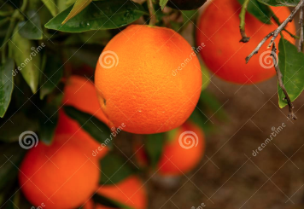
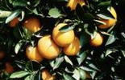
Challenge & Insight
Occlusion, clustering and variable lighting conditions
HSV color space
Feature integration
Graphcut

Slide 6
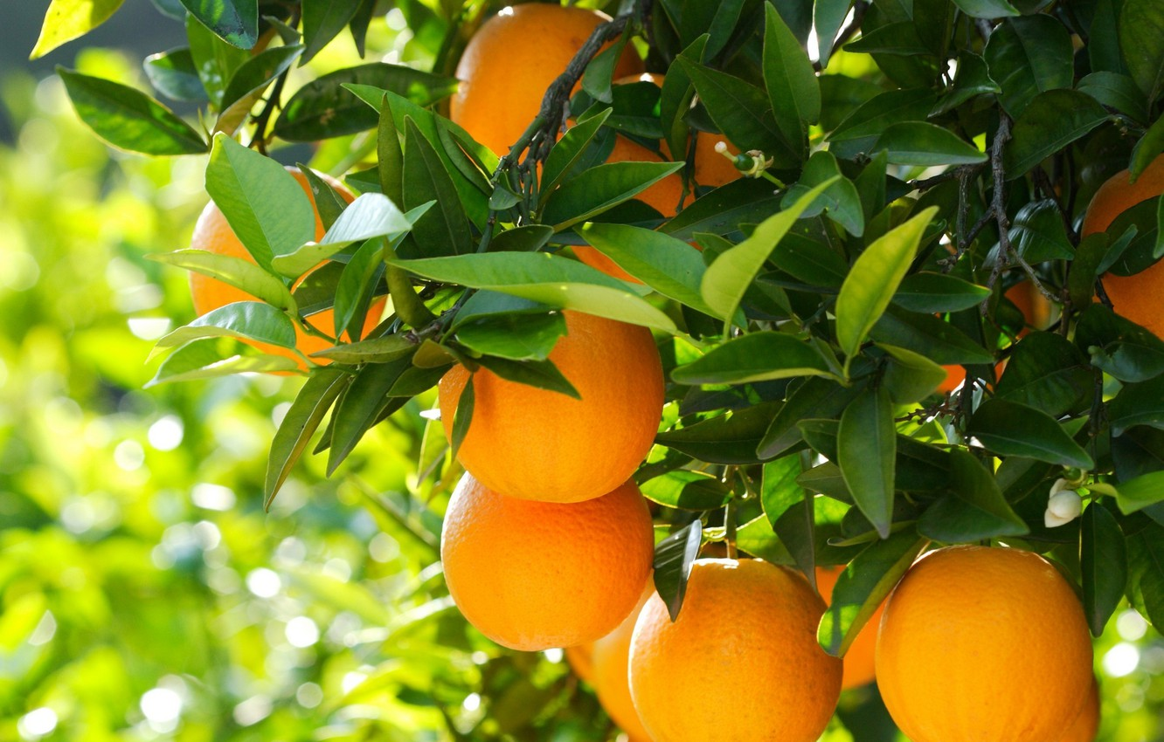
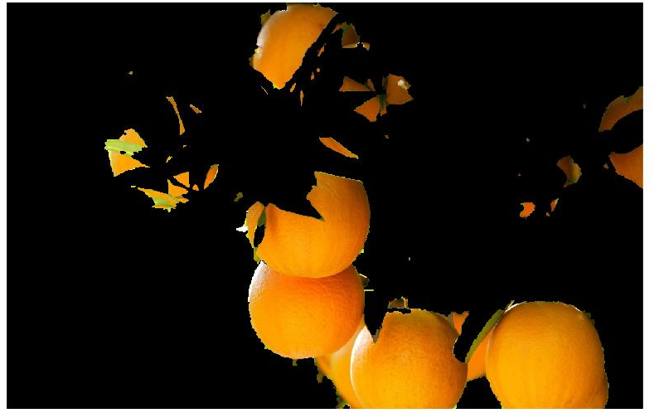
Formulation
A framework of preprocess, feature extraction, feature integration and fruit segmentation.
Multi-scale Gaussian filtering
Feature Extraction
K-means
Clustering
Foreground and background
Feature Integration
Graphcut

Slide 7
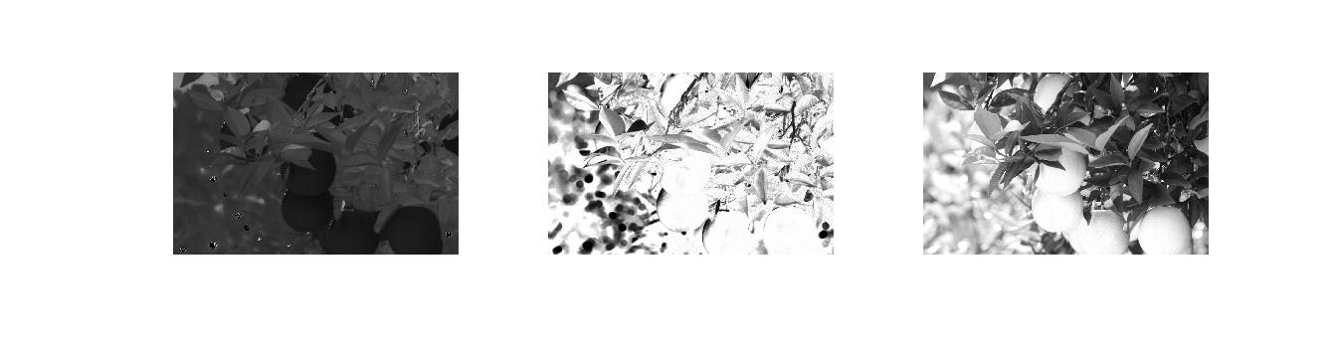

Example
Original image
HSV features
K-means clustering
K = 3 (4); multi-scale gaussian

Slide 8


Cont.
K-means clustering
Binary Labels
Foreground & background

Slide 9
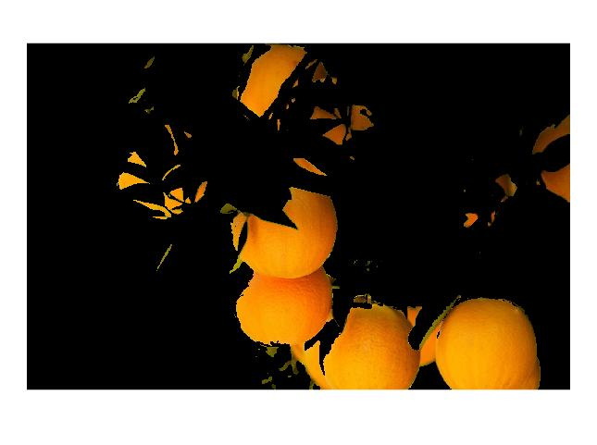
Cont.
Original Image
Initial Foreground
Final Foreground
After Feature integration
After graphcut segmentation

Slide 10
Multi-scale Gaussian filter
+ Essentially, we wanted to employ multi-scale texture or geometric features.
+ Multi-scale gaussian filters is applied in order to filter noise carefully. To be honest, in color feature, it does not bring much improvement.

Slide 11
K-means Setting
+ Instead of threshold method, k-means clusters different class of samples automatically.
+ The value of K is crucial to final results.

Slide 12
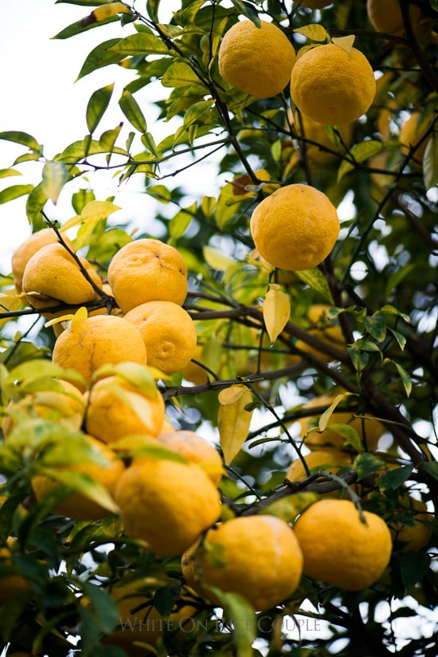
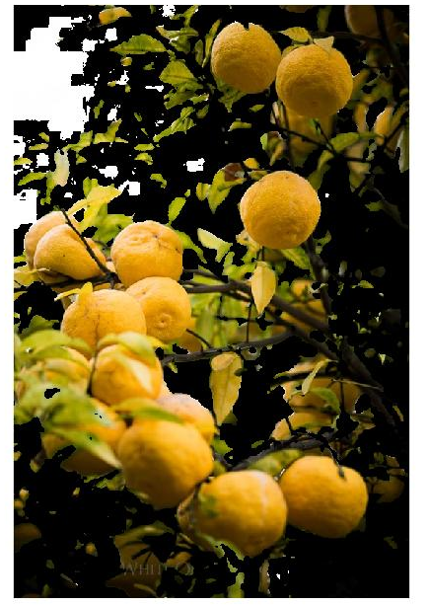
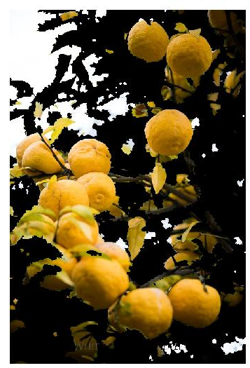
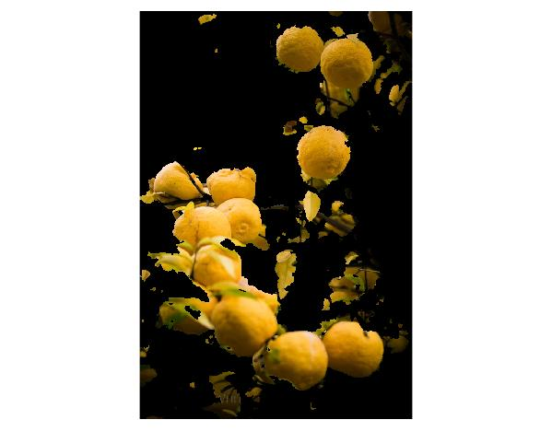
K-means Setting
Original color image
Foreground with K=3
Foreground with K=4
Foreground with K=5

Slide 13
Graphcut
+ Graphcut is used because there are defects and noise in initial foreground.
+ As a tradeoff, outlier may be introduced, which is brought by conservative background.

Slide 14
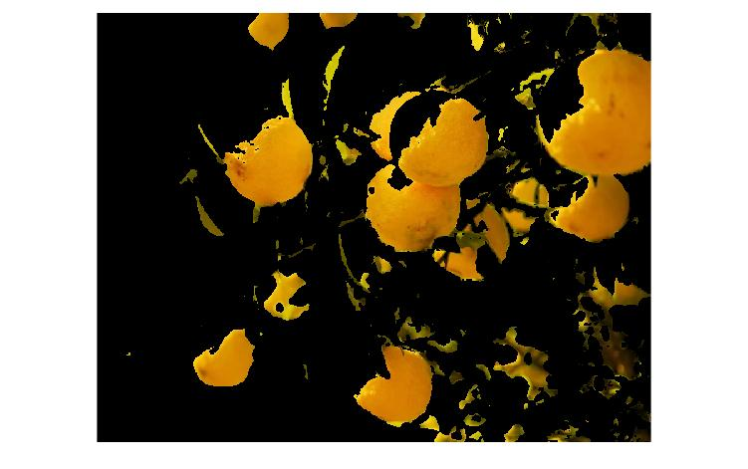
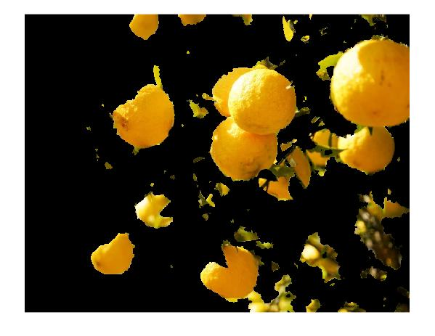
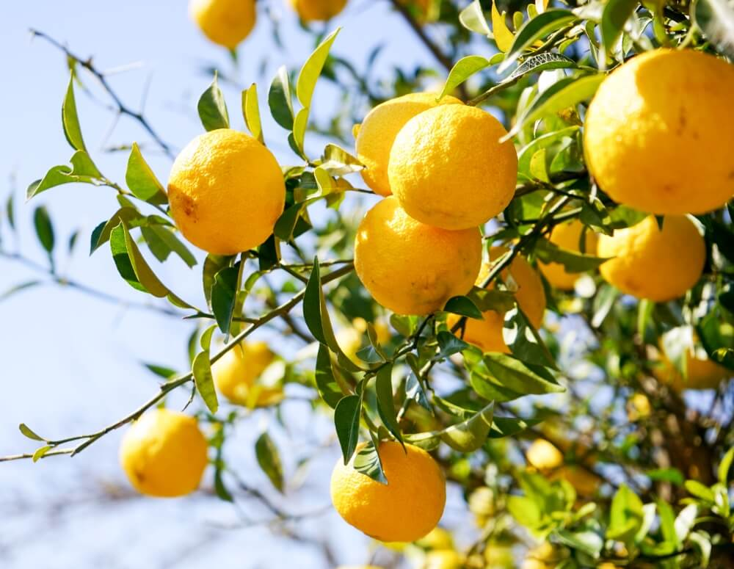
Graphcut
+ Graphcut help overcome variable lighting condition.
Original color image
Foreground before graphcut
Foreground after graphcut

Slide 15
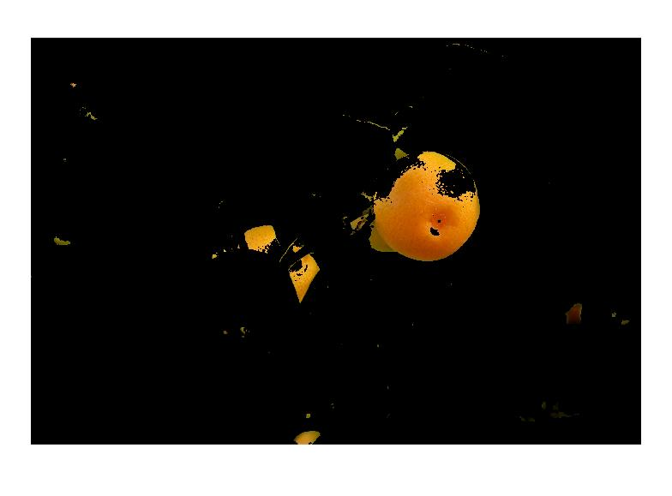

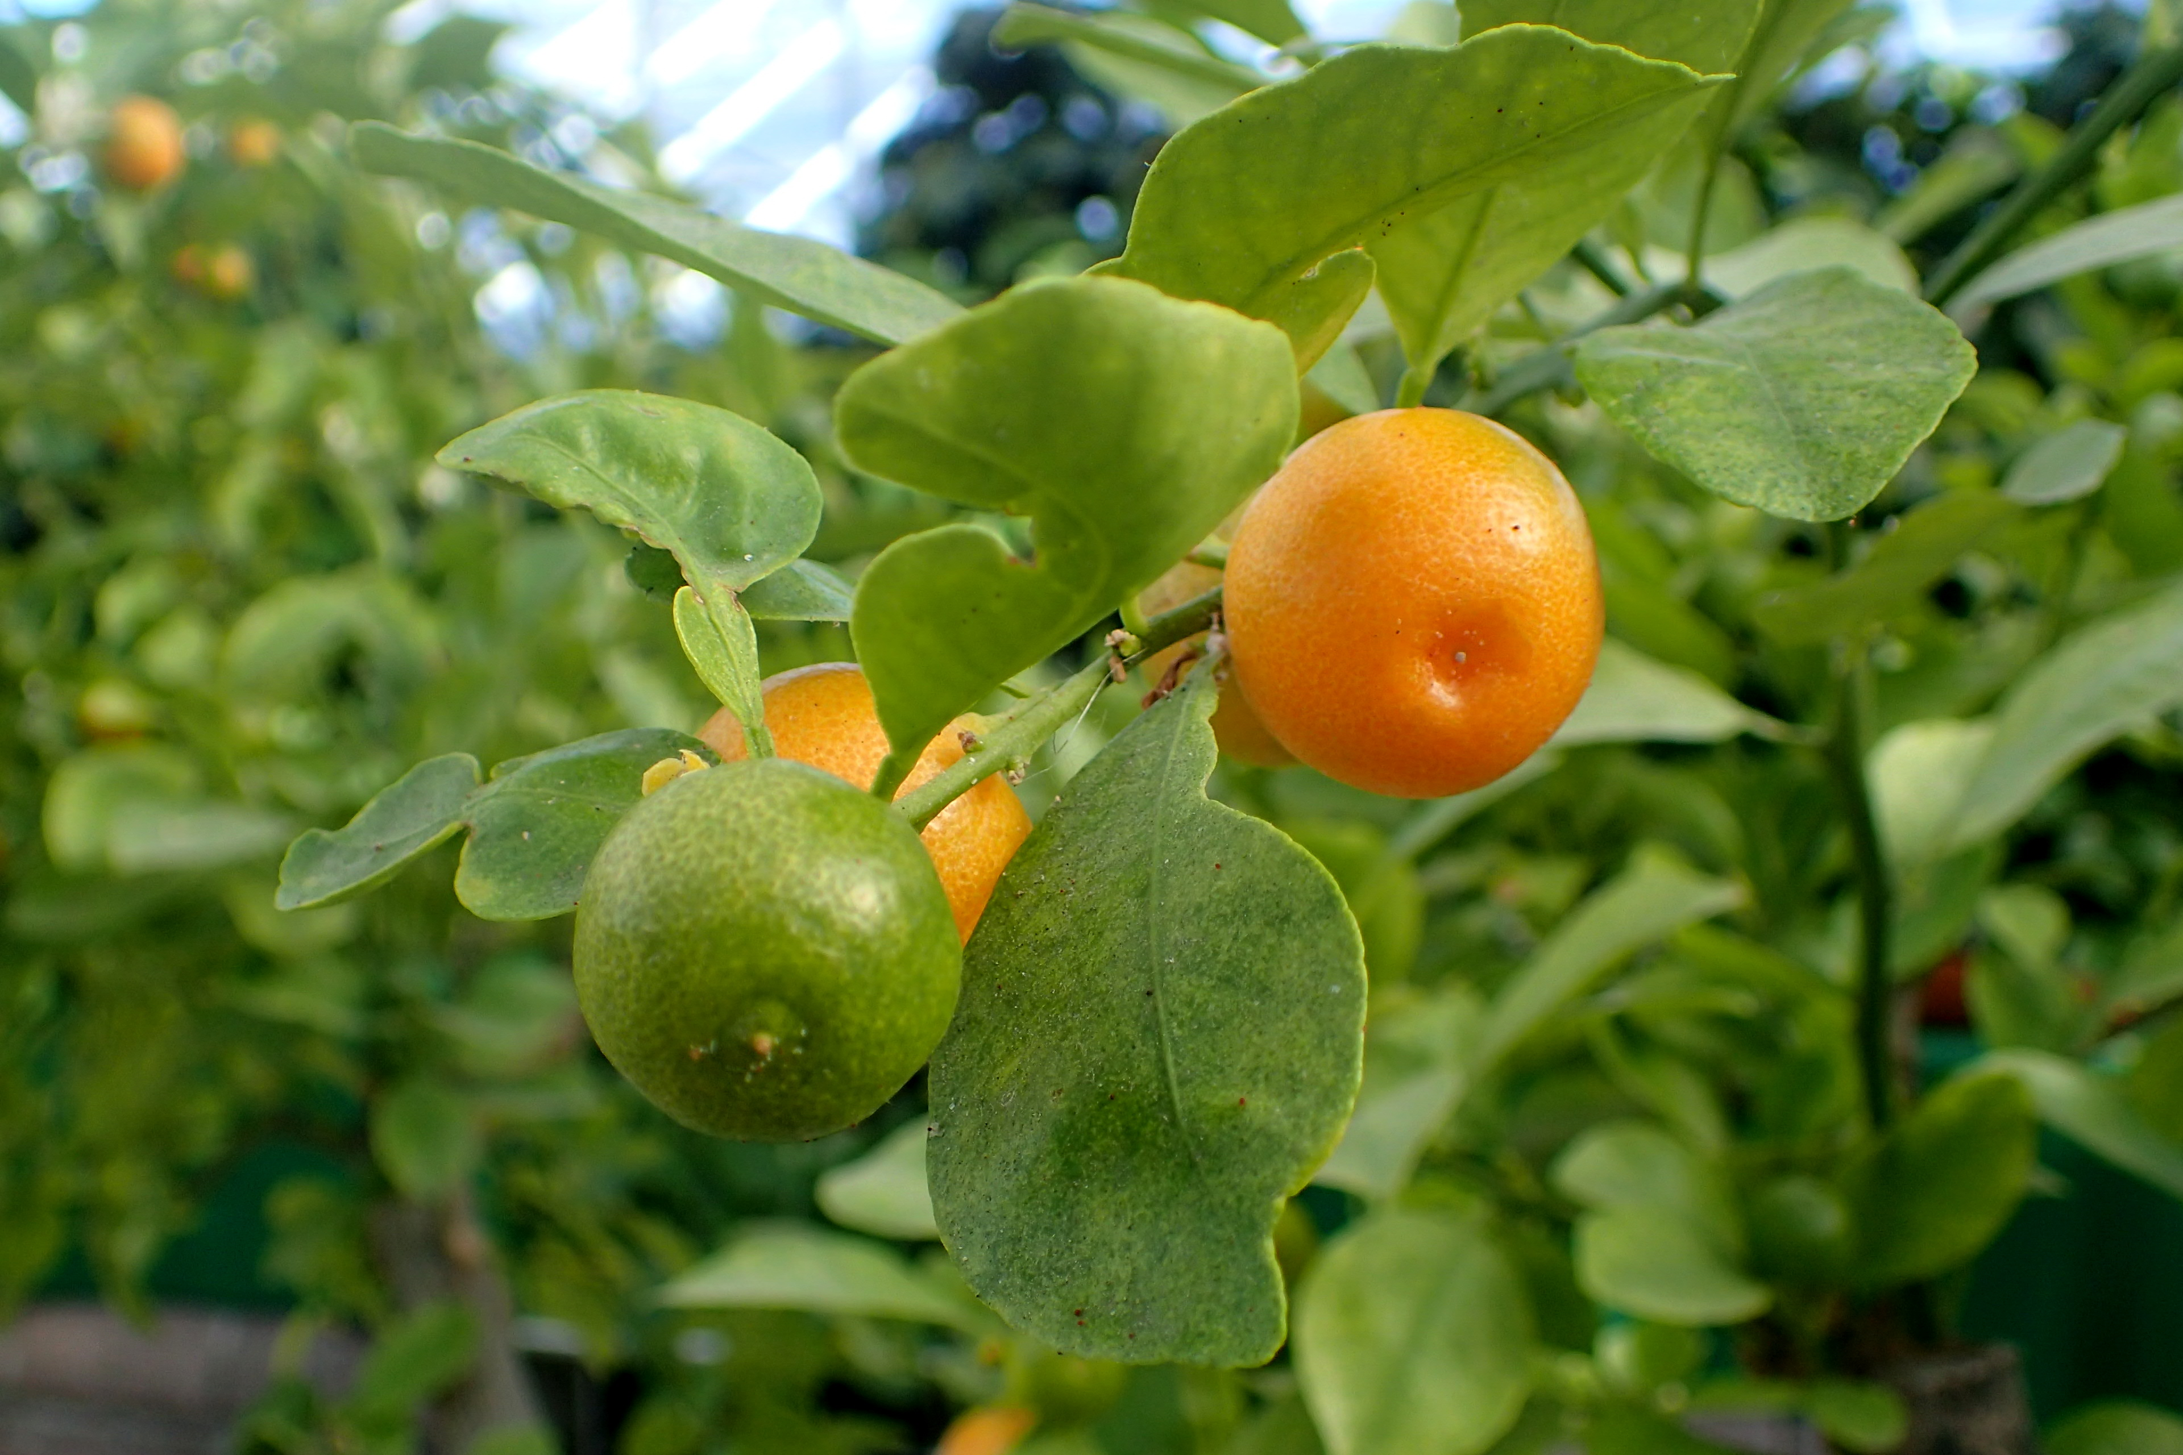

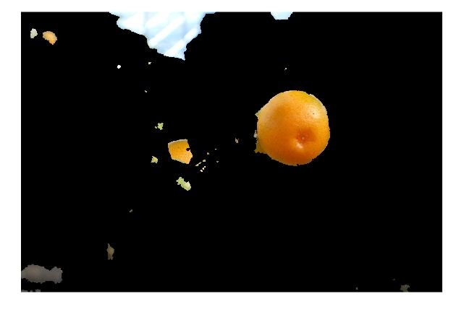
Graphcut
+ Graphcut is robust.
Fig. A weak foreground lead to complete result with graphcut.

Slide 16
Experiments
+ Several types of images: diverse background, fruit size, fruit types
Fig. Citrus with explicit occlusion.

Slide 17
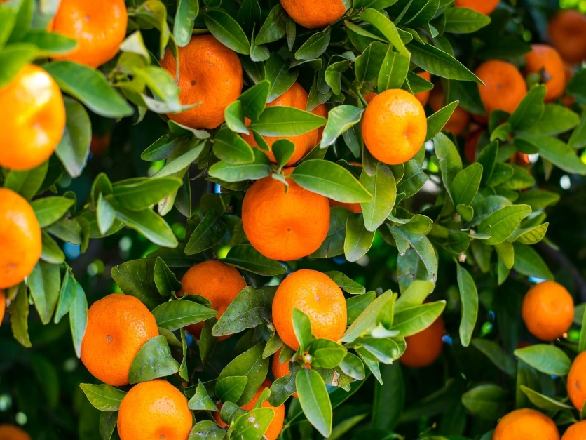
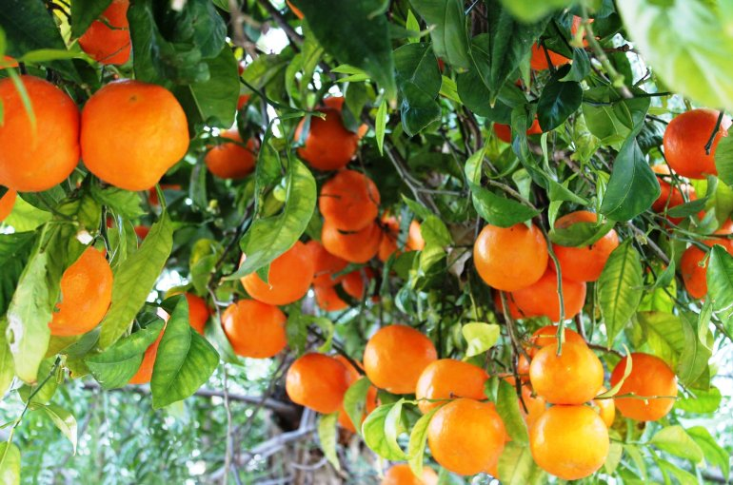
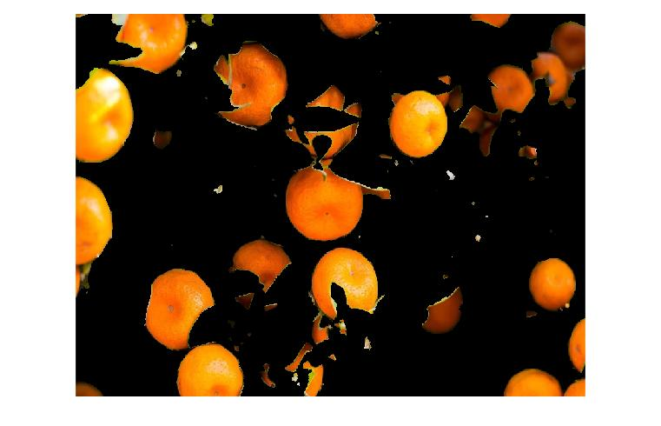
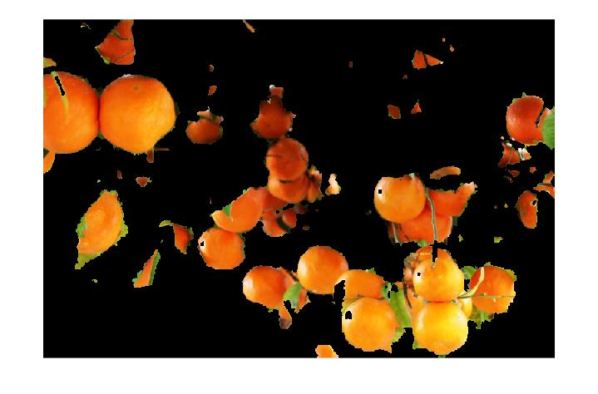
Experiments
+ Our method is size-invariant, and robust to variable light condition.

Slide 18
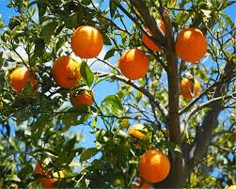
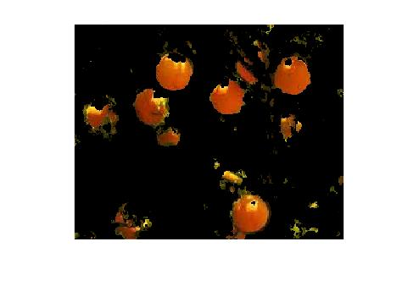
Experiments
+ Diverse background invariant.
+ Similar color invariant.

Slide 19
Discussion & Conclusion
Fruits and leaves with close color (Consider Shape and Texture)
Hue and Saturation and brightness
Tradeoff of Graphcut
Green fruits
K-means (choosing k)
Feature integration
Graphcut

Slide 20
Reference
Gongal, A., Amatya, S., Karkee, M., Zhang, Q., & Lewis, K. (2015). Sensors and systems for fruit detection and localization: A review. Computers and Electronics in Agriculture, 116, 8-19.
Patel, H. N., Jain, R. K., & Joshi, M. V. (2011). Fruit detection using improved multiple features based algorithm. International journal of computer applications, 13(2), 1-5.
Y. Boykov, O. Veksler and R. Zabih (2001), " Fast approximate energy minimisation via graph cuts ", IEEE Transactions on Pattern Analysis and Machine Intelligence, 29, 1222–1239.
MacQueen, J. B. (1967). Some Methods for classification and Analysis of Multivariate Observations. Proceedings of 5th Berkeley Symposium on Mathematical Statistics and Probability. 1. University of California Press. pp. 281–297. MR 0214227. Zbl 0214.46201. Retrieved 2009-04-07.

Slide 21
Pre Title
Name
Date

Slide 22
Title
Contents
..
Remark
List
Aaa
bbb
With Boundary

Slide 23
Re-Check
Do I put the most important insight or challenge on the table?
Do I grasp one concrete example from start to end?
Does introduction clear and easy to understand?
4. Is every definition explanation explained?
..
+ Few words in each page
..

Slide 24
Title
Contents
..

